Slide 1
On Road vehicle breakdown assistance
By Shivani bhojak
Seat no,15238
College name- m.e.s imcc ,pune

Slide 2
Project Scope
On Road Vehicle Breakdown Assistance (ORVBA) Web App is going to be a good solution for the people who seek help in the remote locations with mechanical issues of their vehicle.
The scope of this system is to develop a platform which improve the efficiency of mechanic and user.
This system provide user friendly interface.
ORVBA is used to find the nearest mechanic from the current user location via GPS (Google Maps).

Slide 3
Project Scope
When user will place a service request, the mechanic will get live location of the user and locate using GPS.
User will give review about service.
Users of the On Road Vehicle Breakdown Assistance will be the registered public and they will be getting connected with the particular mechanic through the trustworthy (ORVBA) app.

Slide 4
Modules (Users Of system)
Admin
User
Mechanic

Slide 5
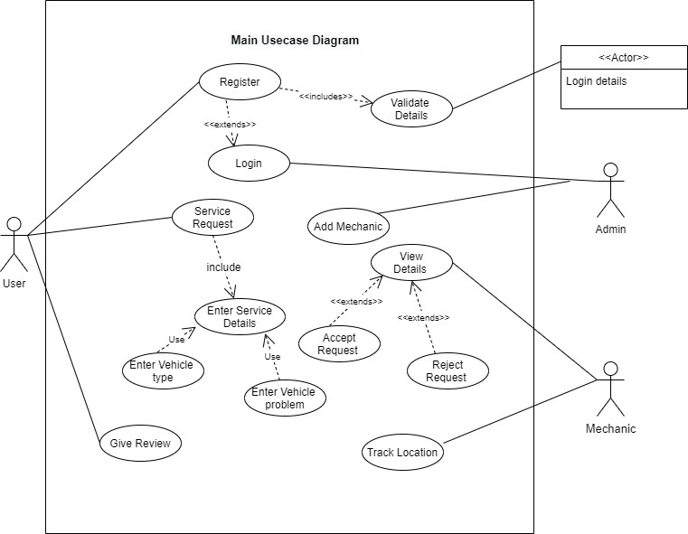
Use Case Diagram

Slide 6
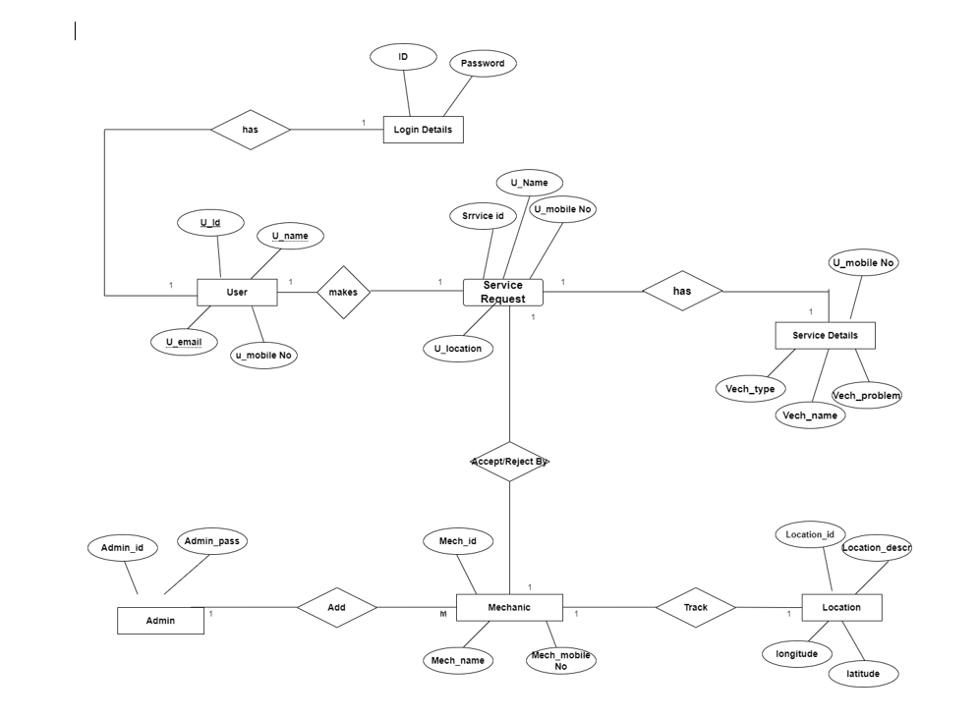
Er Diagram

Slide 7
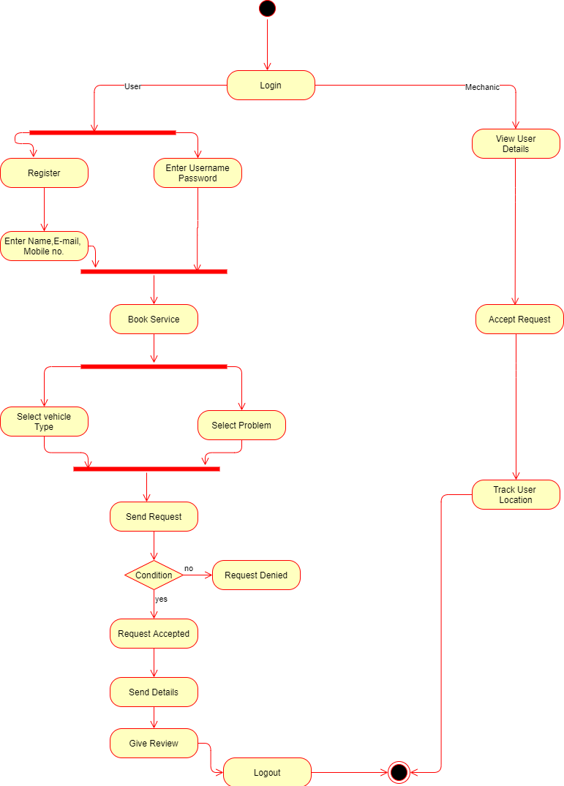
Activity Diagram

Slide 8
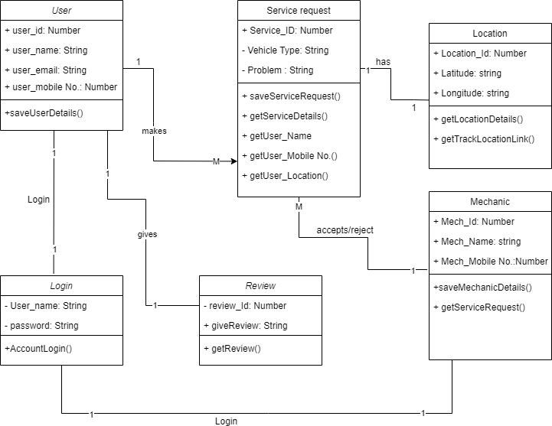
Class Diagram

Slide 9
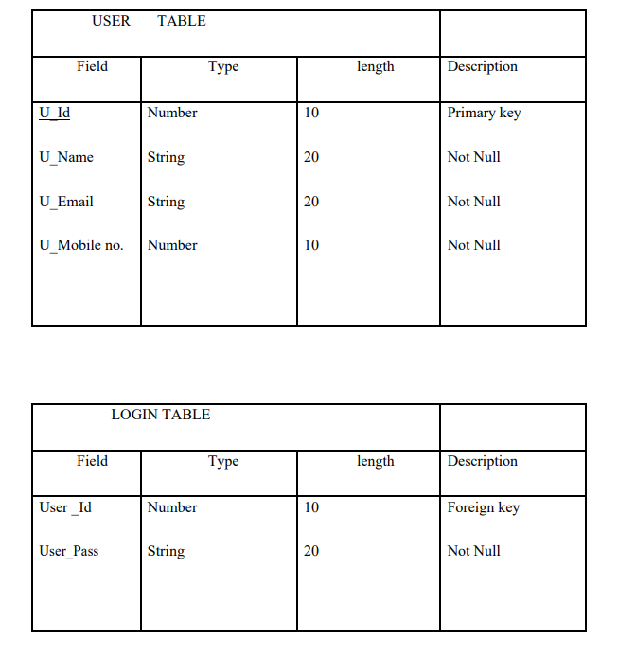
Table Structure

Slide 10
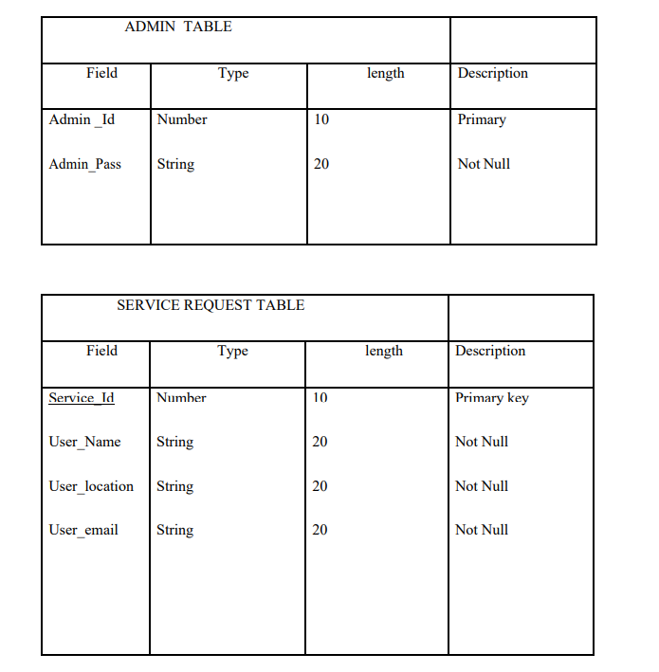
Table Structure

Slide 11
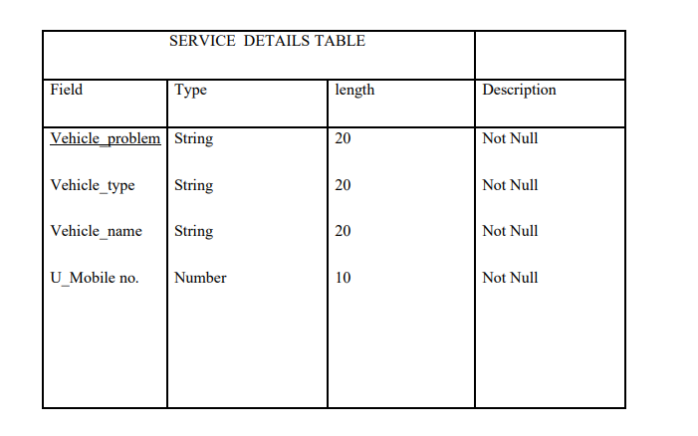
Table Structure

Slide 12
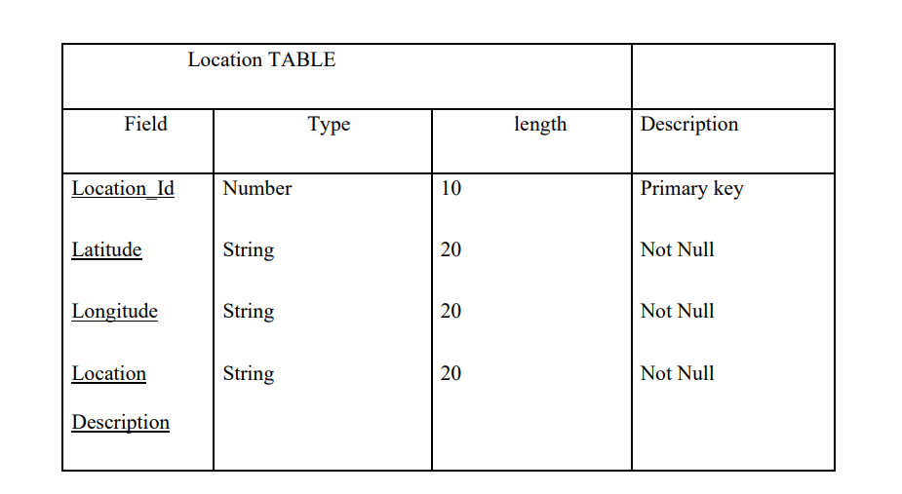
Table Structure

Slide 13
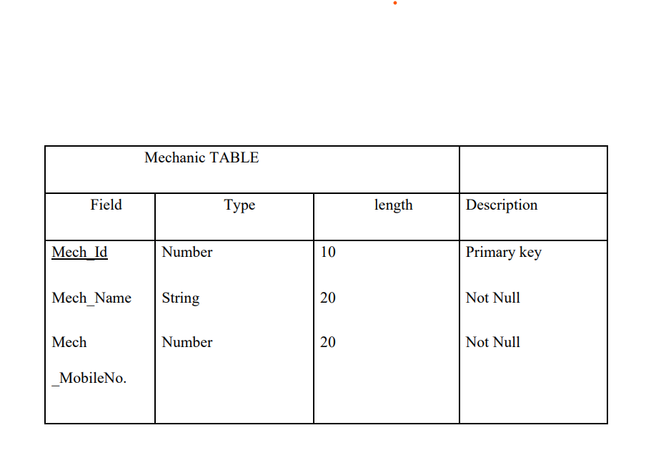
Table Structure

Slide 14
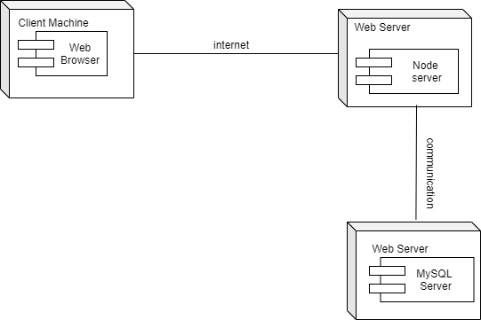
Deployment diagram

Slide 15
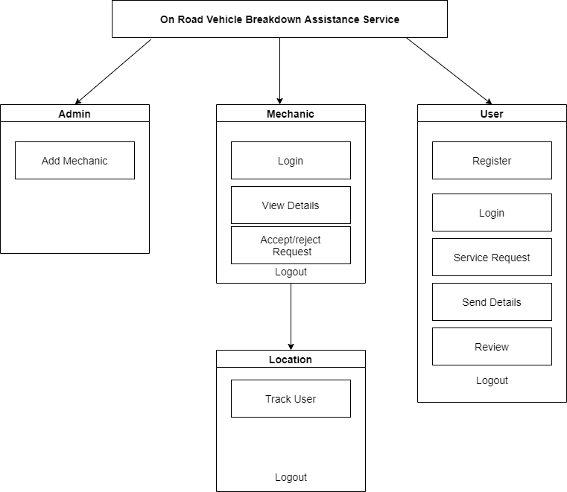
Module hierarchy

Slide 16
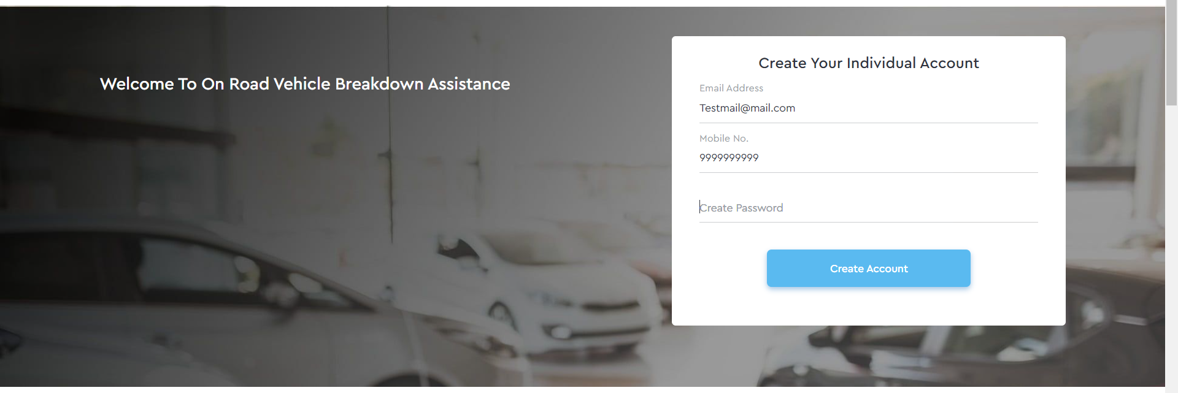
Sample Input and Output Screens
Registration

Slide 17
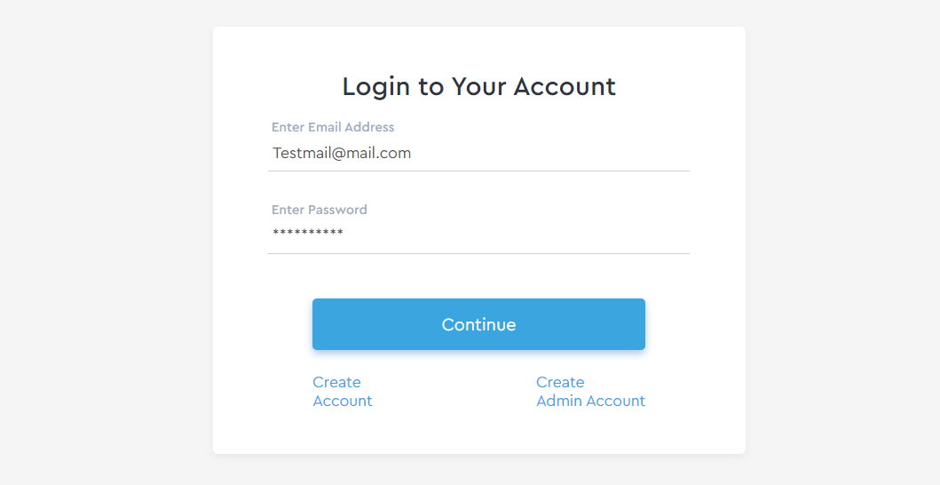
Sample Input and Output Screens
Login

Slide 18
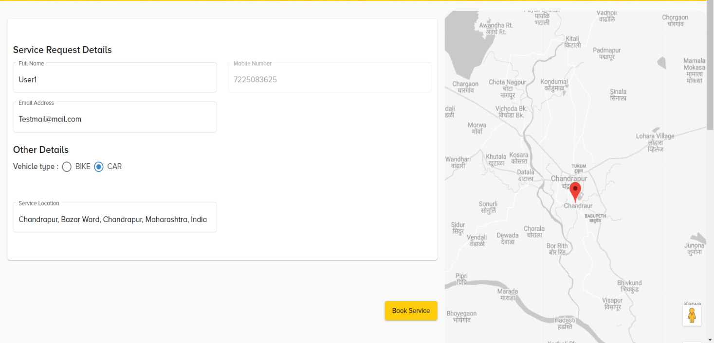
Sample Input and Output Screens
Service Request Page

Slide 19
.
THANK YOU
.

